Slide 1
1.Identified the industry i.e. venture capitalist company. Definition of venture capitalist company: A venture capitalist (VC) is a private equity investor that provides capital to companies exhibiting high growth potential in exchange for an equity stake. This could be funding startup ventures or supporting small companies that wish to expand but do not have access to equities markets. Venture capitalists are willing to risk investing in such companies because they can earn a massive return on their investments if these companies are a success. VCs experience high rates of failure due to the uncertainty that is involved with new and unproven companies.
Step1:Identify an industry

Slide 2
Step1:Identify an industry
Understanding Venture Capitalists:
Contrary to public opinion. VCs do not normally fund startups from the onset. Rather, they seek to target firms that are at the stage where they are looking to commercialize their idea. The VC fund will buy a stake in these firms, nurture their growth and look to cash out with a substantial RETURN OF INVESTMENT(ROI).
Venture capitalists look for a strong management team, a large potential market and a unique product or service with a strong competitive advantage. They also look for opportunities in industries that they are familiar with, and the chance to own a large percentage of the company so that they can influence its direction.

Slide 3
Step1:Identify an industry
Understanding Venture Capitalists:
Venture capitalists are usually formed as limited partnerships(LP) where the partners invest in the VC fund.
The fund normally has a committee that is tasked with making investment decisions.
Once promising emerging growth companies have been identified, the pooled investor capital is deployed to fund these firms in exchange for a sizable stake of equity.

Slide 4
Step1:Identify an industry
Understanding Venture Capitalists:
KEY TAKEAWAYS
A venture capitalist (VC) is an investor who provides capital to firms that exhibit high growth potential in exchange for an equity stake.
VCs target firms that are at the stage where they are looking to commercialize their idea.
Well-known venture capitalists include Jim Breyer, an early Facebook (FB) investor, and Peter Fenton, an investor in Twitter (TWTR).
VCs experience high rates of failure due to the uncertainty that is involved with new and unproven companies.

Slide 5
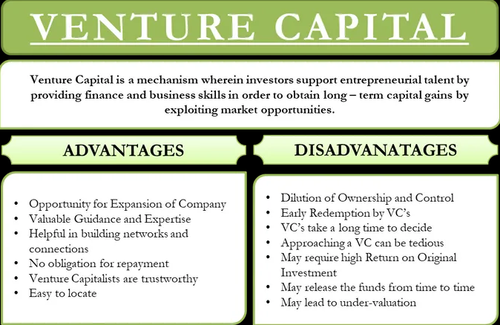
Advantages and disadvantages of Venture capital:

Slide 6
Step2:Identify a company in that industry
Identified a company in Venture capitalist industry: Accel Partners
Understanding Accel Partners:
Accel Partners founded in 1983 has global presence in Palo Alto, London , New York, China and India. Typical multi-stage investments in internet technology companies are made by Accel partners.
Investment Structure: Invests between $0.5 Mn and $50 Mn in its portfolio companies.

Slide 7
Step2:Understanding Accel Partners:
Understanding Accel Partners:
Industries: Internet and Consumer Services, Infrastructure, Cloud -Enabled Services, Mobile and Software.
Startups Funded: Flipkart, BabyOye, Freshdesk, Book My Show, Zansaar, Probe, Myntra, CommonFloor.

Slide 8
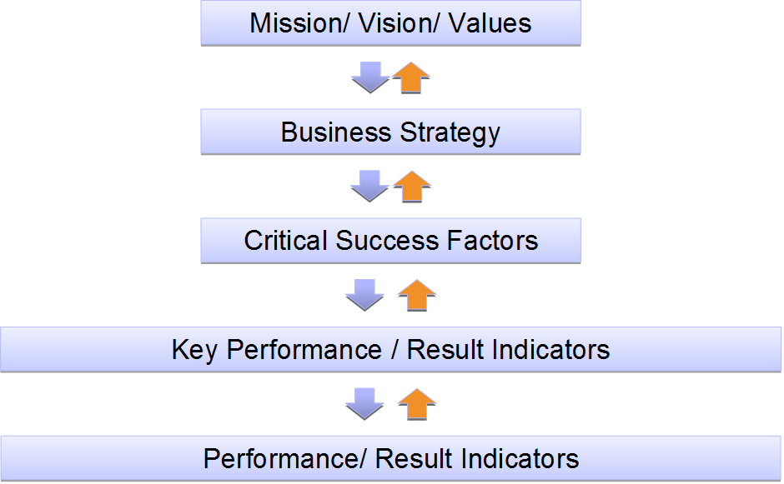
The KPI Framework development

Slide 9
Step2:Identify a company in that industry
Accel Partners Mission, Vision & Values:
Accel Partners Mission Statement
Accel is dedicated to partnering with outstanding entrepreneurs and management teams to build world-class companies, from inception through growth.
Startups Funded: Flipkart, BabyOye, Freshdesk, Book My Show, Zansaar, Probe, Myntra, CommonFloor.

Slide 10
Value Driver Tree:
 |  |  |  |  |  | Management Tactic
 |  |  |  |  |  | Maximize Income
 |  |  |  |  |  | Management Tactic
 |  |  | Strategy |  |  | Improve Demand
 |  |  | Increase Revenue
 |  |  |  |  |  | Management Tactic
 |  |  |  |  |  | Improve Customer Satisfaction
 |  |  |  |  |  | Management Tactic
 |  |  |  |  |  | Increase Brand Ef fectiveness
 |  |  |  |  |  | Management Tactic
 |  |  |  |  |  | Control Operating Expenses
Goal
 |  |  |  |  |  | Management Tactic
Increase Earnings |  |  | Strategy |  |  | Streamline Supply Chain
 |  |  | Reduce
 |  |  | Costs |  |  | Management Tactic
Improve Shareholder
 |  |  |  |  |  | Maximize Employee Utilization
 |  |  |  |  |  | Management Tactic
 |  |  |  |  |  | Improve Process Ef ficiency
 |  |  |  |  |  | Management Tactic
 |  |  |  |  |  | Strengthen Capital Structure
 |  |  |  |  |  | Management Tactic
 |  |  | Strategy |  |  | Increase Asset Utilization
 |  |  | Optimize Capital/ Manage Risk
 |  |  |  |  |  | Management Tactic
 |  |  |  |  |  | Improve Safety
 |  |  |  |  |  | Management Tactic
 |  |  |  |  |  | Optimize Employee Ef fectiveness
Goal: Increase Earnings

Slide 11
Step3:Identify the supply chain entities of that company
1) Three different entities with respect to Supply chain domain:
A) client-pays for the services:
Here it is the venture capitalist company Accel Partners and also the startups which are being funded.
B) Customer –it is the decision making authority:
Here it will be Angel investors, insurance companies, pension funds and wealthy individuals, institutional investors and HEDGE FUNDS.
C) Consumer-one who consume the services –
Here it will be Startups Funded by Accel Partners- for example : Flipkart, BabyOye, Freshdesk, Book My Show, Zansaar, Probe, Myntra, CommonFloor.

Slide 12
Identify the lag KPIs for the start up being funded:
The Burn Rate:
The Burn Rate is the negative cash flow of a company. It shows how quickly a startup is spending money.
This key metric is essential for determining how much cash the company needs to keep operating and growing.
Burn rate is what signals to existing investors how quickly their teams need to be fundraising and the level of risk the company is facing.
It also signals to potential new investors both how quickly you need to raise (i.e. you have less leverage if you’re in a rush) and how much cash you’ll need if they fund you.

Slide 13
Identify the lag KPIs for the start up being funded:
The Burn Rate:
Assuming a constant burn rate can be very dangerous. Always know if your burn rate is going up or down and include that fact in your analysis.
If the startup is just at inception and there is literally no product at all, then the only metric I care about is burn rate.
It's OK if you want to spend money to be aggressive for growth or speed.
The thing that is not OK is if the plans change or environment changes, you should be able to reach profitability on the money you have.
What is OK is to spend money for productivity. What is not OK is just to light money on fire.

Slide 14
Step4 and step 5:Identify the lag and Lead KPIs for the Venture Capitalist:
The five whys analysis:
Commission or ROI earned by the Venture capitalist is diminishing.
WHY?
Consumer earning profit is less and so percentage commission earned by VC is less
WHY?
Consumer is not able to reach desired profitability on the money being funded to them.
WHY?
Consumer is quickly spending money.
WHY?
Consumer is spending money too aggressively for growth or speed which is not working for them as per their plans
WHY?
The Burn Rate of the company funded by VC is high

Slide 15
Step4 and step 5:Identify the lag and Lead KPIs for the Venture Capitalist:
Commission or ROI earned by the Venture capitalist is diminishing: we
Know for sure that this is a LAG KPI for the venture capitalist.
However, through The five whys analysis done in previous slide we come to know that due to Burn Rate of the company funded by VC being high so VC ROI becomes less.
Hence identifying companies with less Burn rate and investing in companies with less burn rate becomes the Lead KPIs for the Venture Capitalist.

Slide 16
Identify the lag KPIs for the start up being funded:
The Activation Rate:
The Activation Rate measures how many visitors are engaging with your website or app.
Activation can be defined several different ways depending on your business including number of clicks, time on website, pages viewed, downloads, email/blog subscription, or even a trial signup.
The Activation Rate can be any action that will lead a visitor to a return visit (retention).
This startup metric measures the first experience a visitor / potential customer has with your product/service/app.

Slide 17
Identify the lag KPIs for the start up being funded:
The Activation Rate:
This startup metric measures the first experience a visitor / potential customer has with your product/service/app.
The top three metrics that are most important for early startups to track are active user numbers, 2nd month retention, and engagement rates.
Do customers just open the product or do they actually use it?

Slide 18
Step4 and step 5:Identify the lag and Lead KPIs for the Venture Capitalist:
The five whys analysis:
Brand effectiveness earned by the Venture capitalist is not improving.
WHY?
Popularity of VC among the prospective
Consumers is negligibly low
WHY?
Current Consumers of VC is not able to increase its customer base and their customer retention rate is also poor
WHY?
Number of visitors engaging with current consumers website or app is less
WHY?
first experience of a visitor / potential customer of product/service/app of the consumer is far from satisfying.
WHY?
The Activation Rate of the company funded by VC is low

Slide 19
Step4 and step 5:Identify the lag and Lead KPIs for the Venture Capitalist:
Brand effectiveness earned by the Venture capitalist is not improving: we Know for sure that this is a LAG KPI for the venture capitalist.
However, through The five whys analysis done in previous slide we come to know that Brand effectiveness of the venture capitalist will directly depend on the success rate of its present consumer base.
But the current consumers success rate is becoming flop because their activation rate is far from being satisfactory.
Hence VC should have an eye on those prospect consumers whose products are impressive and promising. Investing in companies who looks to bring higher Activation Rate would increase the probability of higher success rate of consumers which would effectively consolidate the Brand effectiveness of the venture capitalist and hence this becomes the Lead KPI for the Venture Capitalist.

Slide 20
Identify the lag KPIs for the start up being funded:
Revenue Growth Rate:
If there’s one number every founder should always know, it’s the company’s growth rate. That’s the measure of a startup.
If you don’t know that number, you don’t even know if you’re doing well or badly
The best thing to measure the growth rate of is revenue.
Revenue Growth Rate measures the month-over-month percentage increase in revenue. It’s one of the most common and important startup metrics.
The Revenue Growth Rate provides a solid indicator of how quickly your startup is growing.
f a startup has a basic product or is looking for market fit, then one of the top three metrics I always ask for is MoM (Month on Month) Revenue Growth

Slide 21
Identify the lag KPIs for the start up being funded:
Understanding Revenue Growth Rate:
For very early stage startups, tracking weekly revenue growth will be more helpful to gauge progress.
As a more contextual metric, Revenue Growth Rate helps startups measure comparative progress (month-over-month) instead of an absolute figure (current revenue), which can be deceiving if tracked by itself.
Not only is the growth rate helpful for founders, but investors are also keen to see this metric as they evaluate the startup’s current and potential growth.

Slide 22
Identify the lag KPIs for the start up being funded:
Understanding Revenue Growth Rate:
The month-over-month growth rate can be misleading for very early stage startups since it’s likely that they will see exponential growth at the beginning. The mistaken expectation is that the growth rate will stay the same or even increase, when in reality, the growth rate often decreases (from the initial exponential rate) as the company matures.
For example, a startup might have a growth rate of 150%, 76%, and 88% over the first couple months. But at this point, it’s too early to determine what a sustainable growth rate will be.
It’s quite likely the growth rate will drop as the company matures. When measuring the Revenue Growth Rate, calculate a longer trend (12-18 months) to ensure your percentages reflect an accurate trend and not a one-time exponential growth curve.

Slide 23
Step4 and step 5:Identify the lag and Lead KPIs for the Venture Capitalist:
The five whys analysis:
The Venture capitalist is finding difficult to maximize its income.
WHY?
VC is not able to earn required income by investing its fund on the prospective Consumers
WHY?
Current Consumers of VC is not able to see MoM (Month on Month) Revenue Growth.
WHY?
Current Consumers of VC is able to see exponential growth at the beginning but not able to sustain itself
WHY?
longer trend (12-18 months) reflects a declining trend inspite of initial exponential growth curve.
WHY?
The Revenue Growth Rate of the company funded by VC
Is poor.

Slide 24
Step4 and step 5:Identify the lag and Lead KPIs for the Venture Capitalist:
The Venture capitalist is finding difficult to maximize its income: we can understand that this is a LAG KPI for the venture capitalist.
However, through The five whys analysis done in previous slide we come to know that income of the venture capitalist can be directly attributed to the higher revenue growth of the start up companies funded by them.
But the current consumers are able to see exponential growth in the initial days.However,they are not able to sustain that growth in longer time frame.
Hence VC should have an eye on those prospect consumers whose balance sheets are really promising and those who doesn’t lack in core basic strengths and who have a reliable credibility base with their prospect customers.Making efforts and helping promote consistent revenue growth rate for the start ups funded by VC becomes the Lead KPI for the Venture Capitalist.

Slide 25
Identify the lag KPIs for the start up being funded:
Customer Churn Rate:
Customer Churn Rate is the percentage of customers lost during a given period of time. For SaaS or mobile apps, this means customers who cancel their subscription.
For ecommerce, this means customers who fail to make a repeat purchase within an average timeframe for the business (could be 90 days, 120 days, or some other length of time).
The inverse of this metric is Customer Retention Rate which focuses on the customers retained over a given period of time.

Slide 26
Identify the lag KPIs for the start up being funded:
Customer Churn Rate:
Calculate Customer Churn Rate by dividing the total customers churned over a time period you specify (e.g. month, 90 days, etc.) by the total customers at the start of the time period and then multiply that by 100 to generate a percentage.
For example, if the total customers lost this month was 150 and the total customers at the start of the month is 5,000, then the Customer Churn Rate would be 3%.
150 (total customers churned in August) / 5,000 (total customers as of August 1st) X 100 = 3%

Slide 27
Identify the lag KPIs for the start up being funded:
Customer Churn Rate:
Customer churn helps you see trends in product satisfaction (or dissatisfaction). Analyzing customer churn based on cohorts can be particularly insightful for determining why or what other factors may be influencing customer decisions (e.g. pricing updates, new feature rollout, changes in messaging, etc.).
While customer churn is a helpful metric for detecting a ‘leaky bucket,’ it varies from revenue and doesn’t indicate which customers you’re losing (i.e. high-value customers, low-value customers, or perhaps customers who would be better served with another product).

Slide 28
Step4 and step 5:Identify the lag and Lead KPIs for the Venture Capitalist:
The five whys analysis:
The number of start up consumers on which it has invested its money is constantly reducing.
WHY?
VC is not able to see higher number of start ups approaching it for Business expansion
WHY?
Current Consumers of VC are not able to better its own customers headcount.
WHY?
total new customers for the start up consumer is increasing but still not able to retain old customers
WHY?
Customer Churn Rate is higher compared to Customer Retention Rate for the start up consumers
Higher churn rate and poor retention rate shows poor product satisfaction for the customers of the start ups funded by VC.
WHY?

Slide 29
Step4 and step 5:Identify the lag and Lead KPIs for the Venture Capitalist:
The number of start up consumers on which VC has invested its money is constantly reducing: we can understand that this is a LAG KPI for the venture capitalist.
However, through The five whys analysis done in previous slide we come to know that Higher churn rate and poor retention rate shows poor product satisfaction for the customers of the start ups funded by VC.
This is indirectly impacting the trust of the prospect startups willing to collaborate with the VCs which is leading to VC losing trust and its own loyalty base among the existent and prospect startups which is severely impacting VC own business.
hence going an extra mile and actively help promote and facilitate its own constructive support and technical expertise to help lower churn rate and higher retention rate for the start ups funded by VC in a way helps increase its own consumer base and hence becomes the Lead KPI for the Venture Capitalist.

Slide 30
Step4 :Identify the lag KPI for the Venture Capitalist:
Net Promoter Score:
The Net Promoter Score (NPS) is loyalty metric used in marketing to measure the number of satisfied customers and the average degree of satisfaction.
It’s a survey indexed from -100 to 100 that asks the question “On a scale of 0-10, how likely are you to recommend [company] to a friend or colleague?”
The NPS score serves as a leading indicator to the viral coefficient and word-of-mouth growth.

Slide 31
Step4 :Identify the lag KPI for the Venture Capitalist:
Net Promoter Score:
The Net Promoter Score classifies respondents who selected any number between 0-6 as a detractor.
Respondents who selected 7 or 8 are considered passives and respondents who selected 9 or 10 are considered promoters.
You can calculate your NPS score by subtracting the number of detractors from the number of promoters, divide by the total number of respondents and then multiply by 100.

Slide 32
Step4:Identify the lag KPI for the Venture Capitalist:
Net Promoter Score:
Truly satisfied customers (promoters - those who select 9 or 10 on the survey) will refer their friends and colleagues, so the greater number of satisfied customers, the higher your growth will be.
Research has shown that in most industries the Net Promoter Score accounted for 20-60% of growth. Also, the NPS score is a valuable metric because it’s quantifiable and standardized (leading brands across industries use it).
Breaking down respondents by promoter, passive, or detractor gives you the opportunity to follow up with dissatisfied or passive customers and find out why they’re not promoters. It also helps you weed out the personas who may not be a good fit.
Using the NPS survey is a more traditional approach for measuring customer satisfaction and obviously, relies on customers taking the time to respond. This means you’ll inevitably lack data from some customers who won’t respond for one reason or another. Some experts suggest that your most dissatisfied customer will not respond to NPS surveys, which can give false results.

Slide 33
Step4 :Identify the lag KPI for the Venture Capitalist:
Daily Active Users (DAU) to Monthly Active Users (MAU) Ratio:
The Daily Active Users (DAU) to Monthly Active Users (MAU) Ratio measures the stickiness of your product - that is, how often people engage with your product.
DAU is the number of unique users who engage with your product in a one day window.
MAU is the number of unique users who engage with your product over a 30-day window (usually a rolling 30 days).

Slide 34
Step4 :Identify the lag KPI for the Venture Capitalist:
Daily Active Users (DAU) to Monthly Active Users (MAU) Ratio:
The Daily Active Users (DAU) to Monthly Active Users (MAU) Ratio measures the stickiness of your product - that is, how often people engage with your product.
DAU is the number of unique users who engage with your product in a one day window.
MAU is the number of unique users who engage with your product over a 30-day window (usually a rolling 30 days).
The ratio of DAU to MAU is the proportion of monthly active users who engage with your product in a single day window.

Slide 35
Step4 :Identify the lag KPI for the Venture Capitalist:
Daily Active Users (DAU) to Monthly Active Users (MAU) Ratio:
The metrics we start with are total active users (monthly/weekly/daily) it's growth, alongside any ratios like DAU/MAU or DAU/WAU.
These help us understand how frequently active people are in using the products.
When we assess a growing startup, the number one thing we look for is deeply retained usage.
There are lots of ways for something to grow, but growth without deepening engagement is just like empty calories. So core usage alongside a path to growth is all that matters to us.

Slide 36
Step4 :Identify the lag and lead KPIs for the Venture Capitalist:
Daily Active Users (DAU) to Monthly Active Users (MAU) Ratio:
The best thing , for startups that aren't charging initially, is active users.
That's a reasonable proxy for revenue growth because whenever the startup does start trying to make money, their revenues will probably be a constant multiple of active users.
Hence the growth rate of its revenue is the Lagging KPI which depends on Daily Active Users (DAU) to Monthly Active Users (MAU) Ratio which becomes the leading KPI.
The single most telling metric for a great product is how many of them become dedicated, repeat users.

Slide 37
Step4 :Identify the lag KPI for the Venture Capitalist:
LTV:CAC Ratio:
To understand the marketing metric LTV to CAC ratio, we first need to break down the two components: Lifetime Value (LTV) and Customer Acquisition Cost (CAC).
Lifetime Value (LTV), sometimes referred to as customer lifetime value, is the average revenue a single customer is predicted to generate over the duration of their account.
Customer Acquisition Cost (CAC) is the average expense of gaining a single customer.
The ratio of lifetime value to customer acquisition cost helps you determine how much you should be spending to acquire a customer. Calculating this ratio will show if you’re spending too much per customer or if you’re missing opportunities from not spending enough.

Slide 38
Step4 :Identify the lag KPI for the Venture Capitalist:
Understanding LTV:CAC Ratio:
The average lifetime value of your customers is the average monthly revenue per customer adjusted for monthly churn and gross margin. You can also calculate LTV using annual recurring revenue and annual churn.
The cost of acquiring a customer is simply the sum of all marketing and sales expenses (including salary and overhead costs) over a given period divided by the number of new customers added during that same period.
Once you have both LTV and CAC calculated individually, it’s easy to find the ratio between them. Just divide LTV by CAC. For example, if your customer lifetime value is $3,000 and your expenses for acquiring a customer are $1,000, then your LTV:CAC ratio would be 3:1.

Slide 39
Step4 :Identify the lead and lag KPIs for the Venture Capitalist:
Understanding LTV:CAC Ratio:
Calculating your LTV:CAC ratio is a great way to see if your company is positioned for sustainable growth.
This ratio acts as a barometer for determining how much or how little you should spend on marketing and/or sales to maximize your growth and stay ahead of the competition which have potential to become Lead KPIs for the VC.
The LTV:CAC ratio is a lag KPI that’s great for predicting future growth, but it’s a prediction that can easily change. For example, your LTV could drop if a new competitor enters the market driving up your churn. Or your LTV might increase if you make a really positive product change.

